Slide 1
AuroraShield Enterprise Campus
Next-Generation Cisco-Standard Network Architecture
By Imeda Sheriphadze

Slide 2
Executive Summary
AuroraShield is a fully redundant enterprise network designed for maximum availability.
  Implements Cisco-grade multilayer switching, OSPF routing, VLAN segmentation, and dual-ISP failover.
  Designed by Imeda Sheriphadze — 30+ years IT specialist, 10+ years Neural Network Architect.

Slide 3
High-Level Architecture
Three-tier hierarchical design: Core, Distribution, Access.
  Dual redundant WAN: ISP1 + ISP2 with automatic failover.
  Administrator VLAN70 provides centralized management.
  Independent from Windows Server infrastructure.

Slide 4
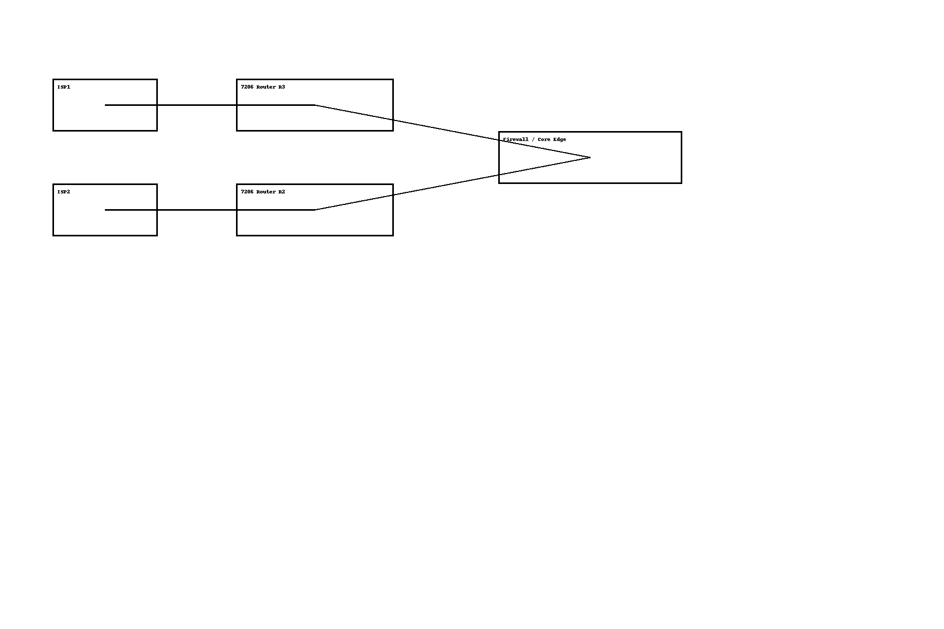
WAN Architecture Diagram

Slide 5
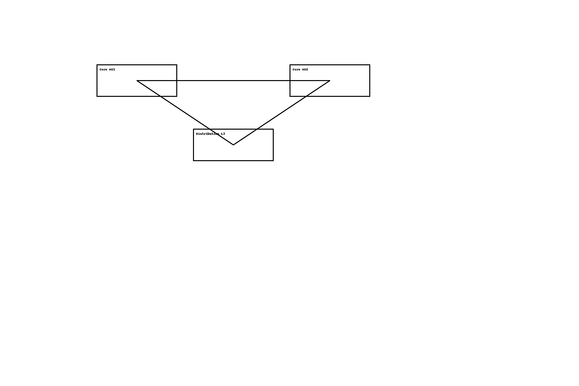
Core Network Diagram

Slide 6
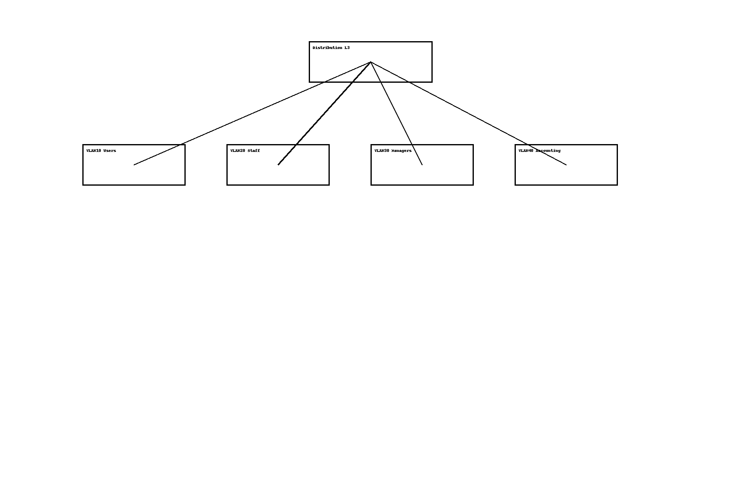
Access Layer Segmentation

Slide 7
Security Architecture
Multi-layer defense with ACL segmentation per VLAN.
  Storm-Control and BPDU Guard against L2 attacks.
  Admin VLAN70 isolated and access-controlled.
  Edge filtering prevents untrusted network intrusion.

Slide 8
Administrator Zone (VLAN70)
Centralized management on Windows 10 Pro.
  Performs monitoring, diagnostics, configuration tasks.
  Protected through ACLs and isolation policies.
  No dependency on server-side components.

Slide 9
OSPF Routing Design
Single-area OSPF (Area 0) for optimal convergence.
  Point-to-point interface mode for clean LSAs.
  MD5 authentication ensures routing security.
  Fast failover with tuned hello/dead timers.

Slide 10
Testing & Validation
100% successful inter-VLAN communication tests.
  ISP failover validated using IP SLA tracking.
  OSPF adjacency and ECMP routing verified.
  Security and port-protection validated.

Slide 11
Final Conclusion
AuroraShield is a resilient, secure, and enterprise‑ready network.
  Built using Cisco Validated Design principles.
  Ready for official Cisco-level inspection and certification.
  Architect: Imeda Sheriphadze.

